Slide 1
Why to choose nosql?
GROUP NO:-12
GROUP MEMBERS:-
HIMANSHU PANDEY(20)
NISHANT BHAT(41)
BHARGAV PAWAR(46)
SHYAM KAWALE(27)
ABHIJEET GAWAI(18)

Slide 2
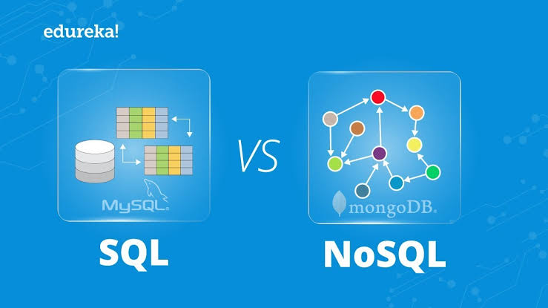
INTRODUCTION
From so many years relational database like SQL is the main model which is used for database management.
But as of present non-relational databases like ‘NoSQL’ are gaining an importance as an alternate platform for database management

Slide 3
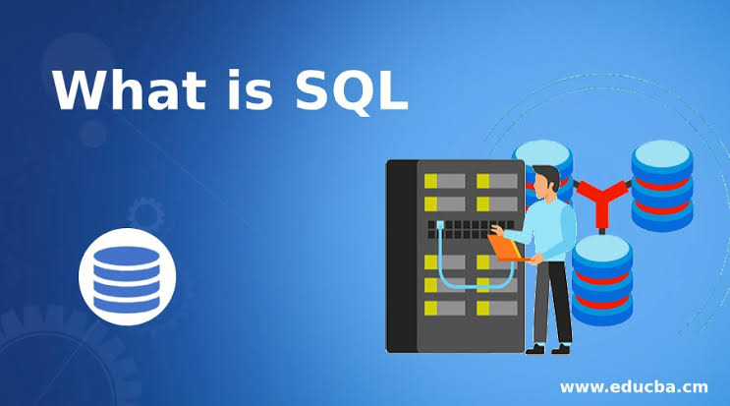
What is sql?
SQL stands for Structured Query Language.
It is a standard programming language that lets us access and manipulate databases.
It is used to execute queries, retrieve data, insert records, update records, delete records, create new tables in a database through different queries.
A SQL server has a set of tables containing predefined categories or columns.

Slide 4
Limitations of sql
SQL is most commonly used database language but at the same time it can be limiting.
The main requirement for SQL is predefined schema to determine the structure of data.
It must follow the same structure. This requires significant up-front preparation and it means a change in the structure can disturb a whole system.
It means it does not support rows having dissimilar columns.

Slide 5
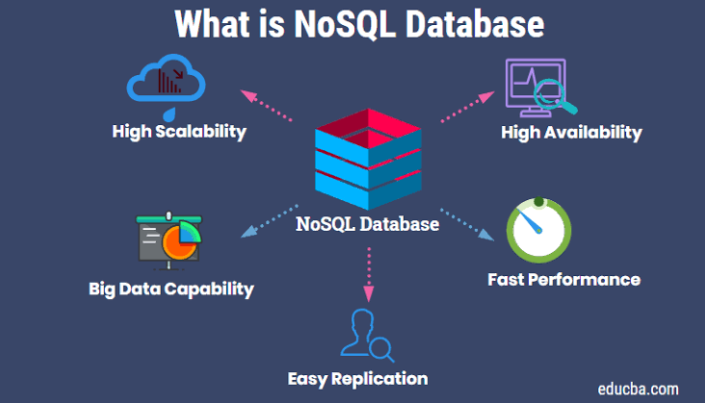
What is ‘nOsql’ ?
NoSQL stands for ‘not only SQL’.
It is a kind of database model that is not required to follow an particular relational schema.
It provides us with different features as:-
Creating documents without the need to predefine their structure
Unique structure of each document
Varying syntax can be used from database to database

Slide 6
Nosql-an alternative for sql
In real world, as we are handling an immense amount of data and having this data in organized and well-structured manner actually creates a slow down performance of the system. Thus this approach of RDBMS database like SQL reduces efficiency
Unlike SQL, NoSQL is believed to be a completely different database platform which provides us high performance, fast processing of information at larger volume. This is a database suitable to the needs of big data.

Slide 7

Benefits of nosql
THE SCALABILITY
Bigger DATA HANDLING CAPABILITY
SUPPORT FOR UNSTRUCTURED TEXT
SUPPORT FOR MULTIPLE DATA STRUCTURE
LESSER SERVER COST
ABILITY TO HANDLE CHANGE OVER TIME

Slide 8
Limitations of nosql
NoSQL is very new in comparison to SQL and is not as stable don’t have much functionalities.
NoSQL is not at all compatible with SQL.
Most NoSQL databases do not perform ACID transactions, a technique for ensuring that data remains consistent across the entire database as it is moved around.

Slide 9
conclusion
NoSQL and SQL are both good platforms for database management.
No doubt NoSQL is gaining its ground but both have their own advantages and limitations.
So keeping in mind the limitations of both we should select the one which we will prove more fruitful to us.

